Slide 1



FPT Software
ANDROID TRAINING
LESSON 12
Version 0.1

Slide 2
Agenda
Gestures
Built-in gesture detectors
Handling Common Single-Touch Gestures
Handling Common Multi-Touch Gestures
2/11/2012
Android Insights - 3
<number>/18

Slide 3
Gestures
Touch screens are a great way to interact with applications on mobile devices. With a touch screen, users can easily tap, drag, fling, or slide to quickly perform actions in their favorite applications.
For app developers. the Android framework makes it's easy to recognize simple actions, like a swipe, but it has been more difficult to handle complicated gestures, sometimes requiring developers to write a lot of code.

Slide 4
Gestures
Built-in gesture detectors provided in the Android SDK to detect common user motions in a consistent fashion: Gesture Builder and GestureOverlayView
Android currently has two different classes that can detect navigational gestures:
  The GestureDetector class can be used to detect common single-touch gestures.
  The ScaleGestureDetector can be used to detect multi-touch scale gestures.

Slide 5
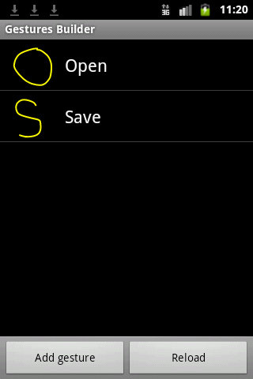
Built-in gesture detectors
Creating a gestures library
  Starting with version 1.6 and higher the Android Emulator includes a new application pre-installed, called Gestures Builder.
  Start the Android Emulator and use the Gesture Builder application to create the “S” and “O” gestures

Slide 6
Built-in gesture detectors
Importing gesture to project
  Every time we create or edit gestures with Gesture Builder, a file is created on the emulator SD card: /sdcard/gestures. We should import this file into our /res/raw project directory.
  In order to do this, open the FileExplorer tab in the DDMS perspective. (If you don’t have the FileExplorer tab available, add it from: Window -> Show View -> File Explorer). Navigate to /sdcard directory and copy the gesture file to your computer, for example on your desktop.

Slide 7
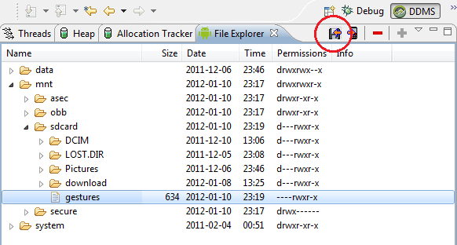
Built-in gesture detectors

Slide 8
Built-in gesture detectors
Loading the gesture library and recognizing the gesture
  To start recognizing gesture in our application we have to add the GestureOverlayView to our XML layout file.
  There are 2 ways you can use the GestureOverlayView, one of them is to use it as a normal view embedded inside a LinearLayout for example, and another is to use it as an overlay on top of other views.

Slide 9
Built-in gesture detectors
Make the AndroidGestureActivity to implement the OnGesturePerformedListener interface and add the the mLibrary member variable of type GestureLibrary:
  public class AndroidGestureActivity extends Activity implements OnGesturePerformedListener {
  GestureLibrary mLibrary;

Slide 10
Built-in gesture detectors
In the onCreate() method we load the library and add the GestureOverlayView to the listener:
  @Override
  public void onCreate(Bundle savedInstanceState) {
  super.onCreate(savedInstanceState);
  setContentView(R.layout.main);
  mLibrary = GestureLibraries.fromRawResource(this, R.raw.gestures);
  if (!mLibrary.load()) {
  finish();
  }
  GestureOverlayView gestures = (GestureOverlayView)
    findViewById(R.id.gestures);
  gestures.addOnGesturePerformedListener(this);
  }

Slide 11
Built-in gesture detectors
Implementation of onGesturePerformed(), when the listener is triggered, a list of predictions and a score is returned, each with the name you entered earlier in the Gesture Builder.

Slide 12
Built-in gesture detectors
public void onGesturePerformed(GestureOverlayView overlay, Gesture gesture) {
ArrayList<Prediction> predictions = mLibrary.recognize(gesture);
if (predictions.size() > 0 && predictions.get(0).score > 1.0) {
String result = predictions.get(0).name;
if ("open".equalsIgnoreCase(result)) {
Toast.makeText(this, "Opening the document", Toast.LENGTH_LONG).show();
} else if ("save".equalsIgnoreCase(result)) {
Toast.makeText(this, "Saving the document", Toast.LENGTH_LONG).show();
}
}
}

Slide 13
Handling Common
Single-Touch Gestures
GestureDetector
  A GestureDetector is an Android class that can take motion events, do some mathematical magic to determine what they are, and then delegate calls to a GestureListener object as specific gesture or other motion callbacks.

Slide 14
Handling Common
Single-Touch Gestures
Connecting the GestureDetector
  Wire up the GestureDector object called gestures to receive events. To do this, override the View control’s onTouchEvent() method within the View class as follows:
    @Override
    public boolean onTouchEvent(MotionEvent event) {
    return gestures.onTouchEvent(event);
    }

Slide 15
Handling Common
Single-Touch Gestures
Implementing a Gesture Listener
  In order to react to the events recognized by the GestureDetector class, we need to implement the GestureListener class. The motion events we are most interested in are double taps and gestures of any kind. To listen for these types of motion events, our GestureListener class must implement both the OnGestureListener and OnDoubleTapListener interfaces.
    private class GestureListener implements GestureDetector.OnGestureListener, GestureDetector.OnDoubleTapListener {
    PlayAreaView view;
    public GestureListener(PlayAreaView view) {
    this.view = view;
    }
    }

Slide 16
Handling Common
Single-Touch Gestures
OnGestureListener
  onDown: Called when the user first presses on the touch screen.
  onShowPress: Called after the user first presses the touch screen but before he lifts his finger or moves it around on the screen; used to visually or audibly indicate that the press has been detected.
  onSingleTapUp: Called when the user lifts up (using the up MotionEvent) from the touch screen as part of a single-tap event.
  onLongPress: Similar to onSingleTapUp, but called if the user holds down his finger long enough to not be a standard click but also without any movement.
  onScroll: Called after the user presses and then moves his finger in a steady motion before lifting his finger. This is commonly called dragging.
  onFling: Called after the user presses and then moves his finger in an accelerating motion before lifting it. This is commonly called a flick gesture and usually results in some motion continuing after the user lifts his finger.

Slide 17
Handling Common
Single-Touch Gestures
OnDoubleTapListener
  onSingleTapConfirmed: Called when a single-tap event occurs.
  onDoubleTap: Called when a double-tap event occurs.
  onDoubleTapEvent: Called when an event within a double-tap gesture occurs, including any down, move, or up MotionEvent.

Slide 18
Handling Common
Multi-Touch Gestures
Introduced in API Level 8 (Android 2.2), the ScaleGestureDetector class can be used to detect two-fingered scale gestures.
The scale gesture enables the user to move two fingers toward and away from each other. When the fingers are moving apart, this is considered scaling up; when the fingers are moving together, this is considered scaling down. This is the “pinch-to-zoom” style often employed by map and photo applications.

Slide 19
Handling Common
Multi-Touch Gestures
ScaleGestureDetector
  Detects transformation gestures involving more than one pointer ("multitouch") using the supplied MotionEvents.
This class should only be used with MotionEvents reported via touch. To use this class:
  Create an instance of the ScaleGestureDetector for your View
  overriding the onTouchEvent(MotionEvent) method to pass the MotionEvent objects to the gesture detector

Slide 20
Handling Common
Multi-Touch Gestures
ScaleGestureDetector.OnScaleGestureListener callback will notify users when a particular gesture event has occurred.
  onScale(ScaleGestureDetector detector) Responds to scaling events for a gesture in progress.
  onScaleBegin(ScaleGestureDetector detector) Responds to the beginning of a scaling gesture.
  onScaleEnd(ScaleGestureDetector detector) Responds to the end of a scale gesture.

Slide 21
Homework
Move actor on animation example by touch on screen
Zoom, scroll graph example

Slide 22
Thank you!

